Slide 1
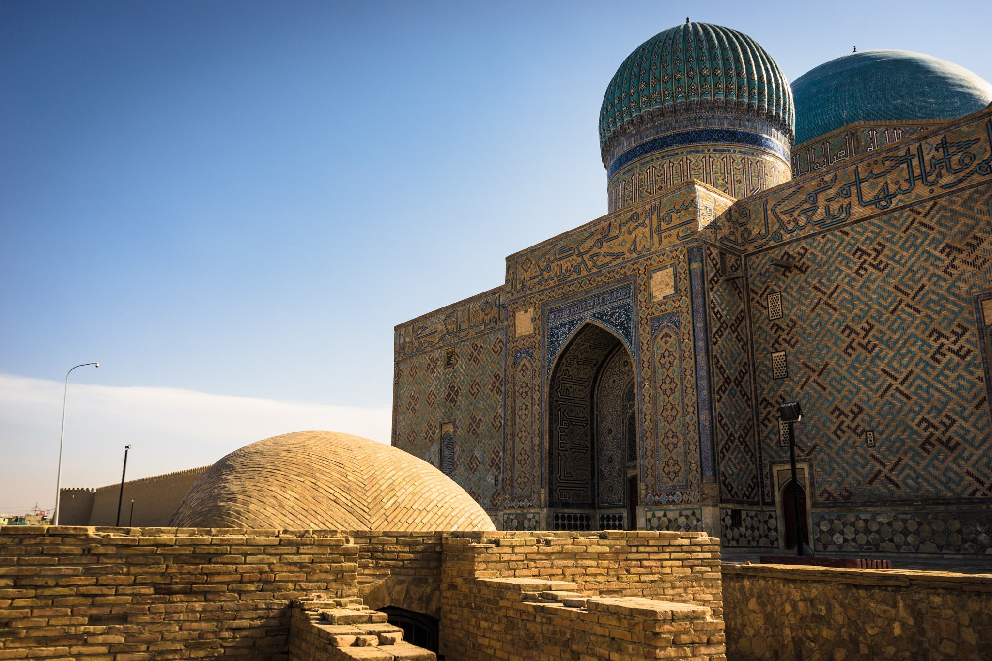

Slide 2
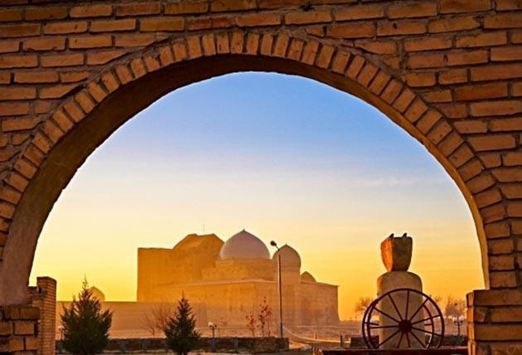
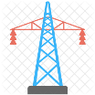
“Turkistan” Industrial zone
Area:
350 hectare
Infrastructure :
Sewage 4 kм
143 ₸ / м3
S
Water
11,9 kм
142,4 ₸ / м3
Natural gas
3 kм
32,2 ₸ / м3
Electricity 23,3 kм
22,6 ₸ / kVт
Railways 4 km
Location:
9 km from “Western Europe-Western China” international road.
Brownfield
Brownfield 3 pieces - 1 075 mil
Completion date :September 2019

Slide 3
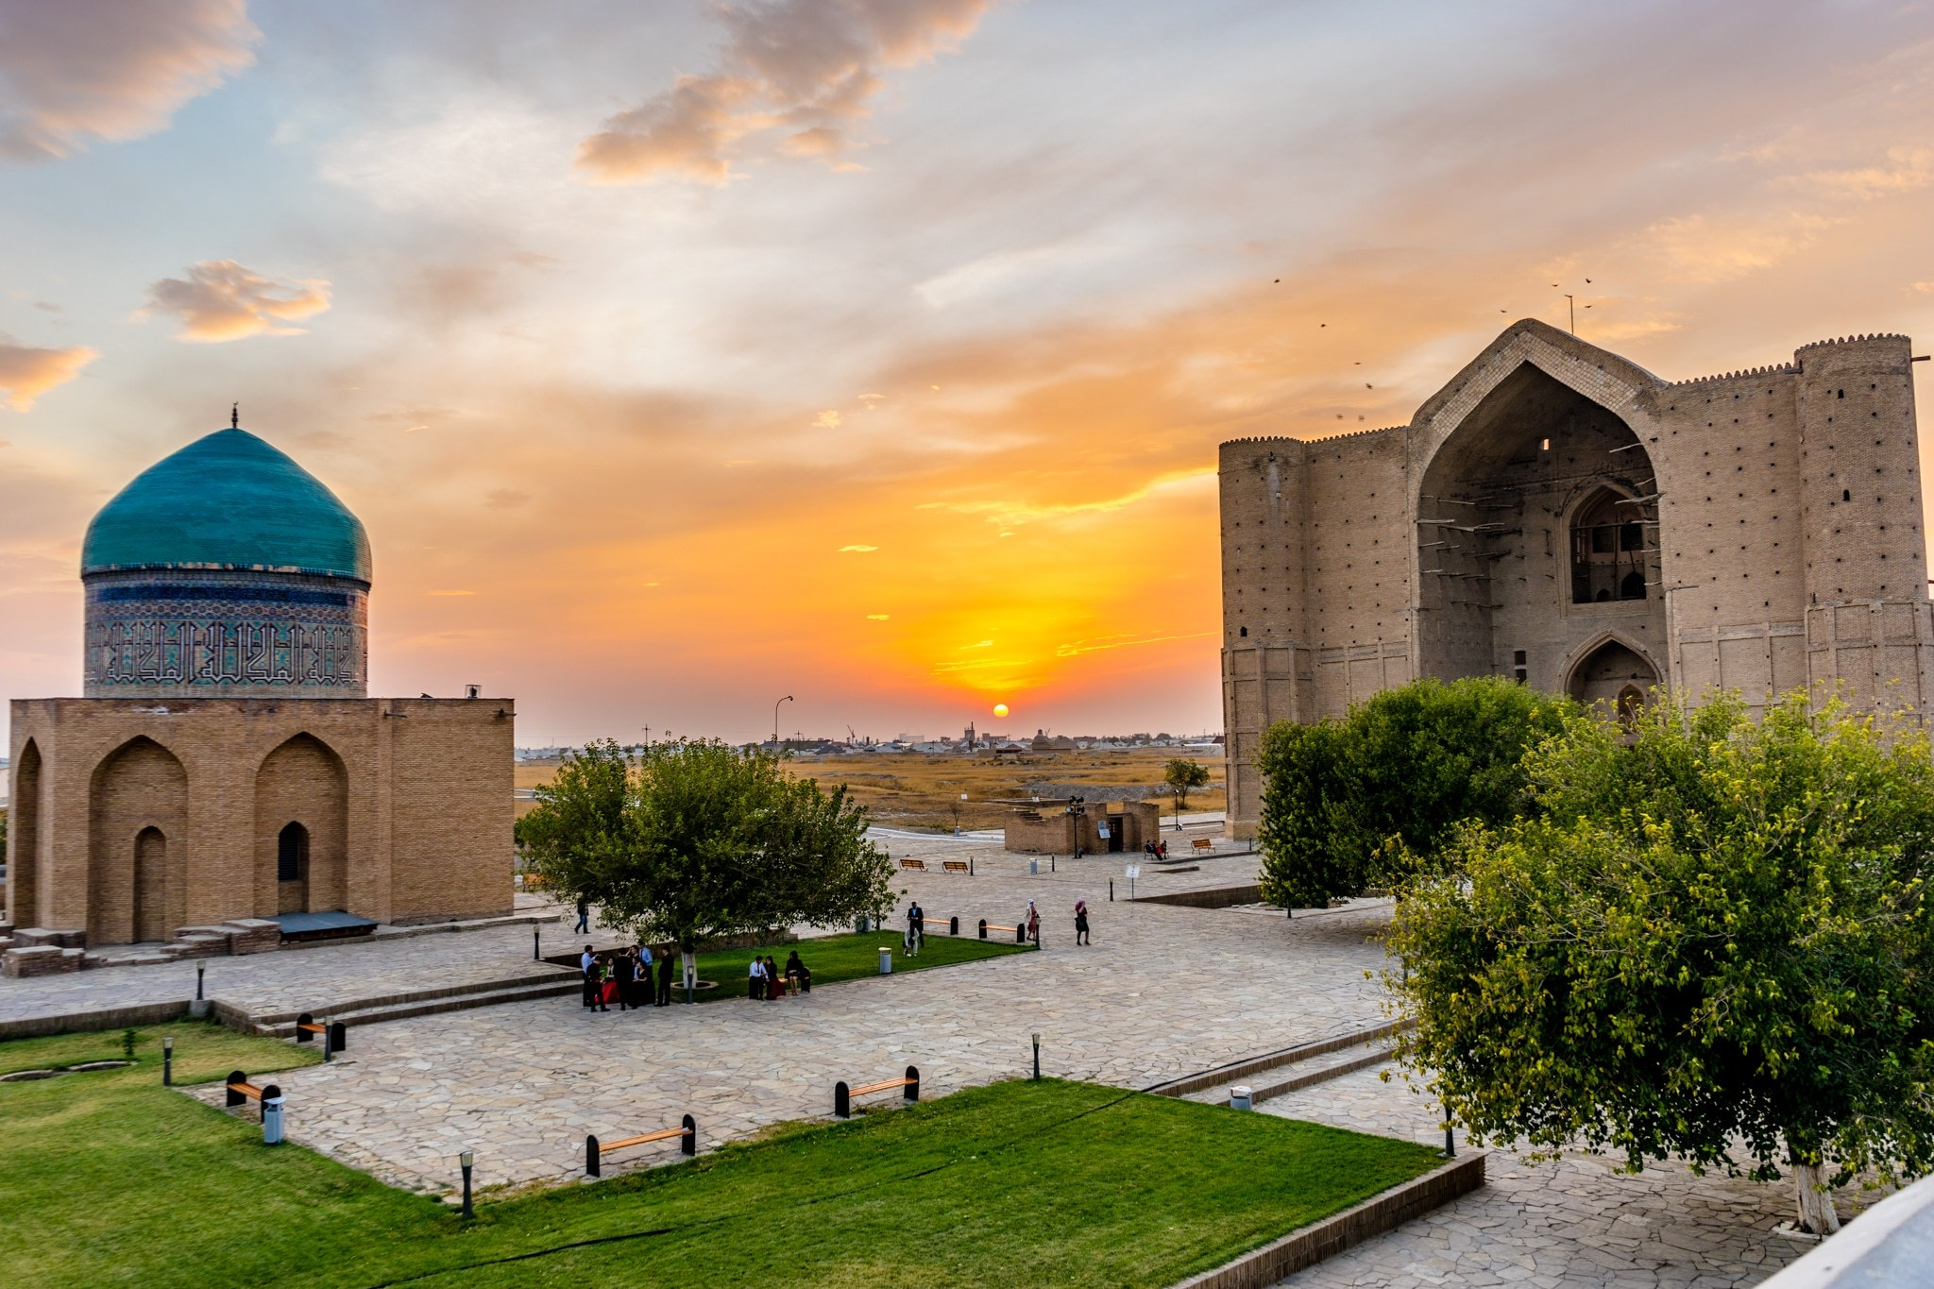
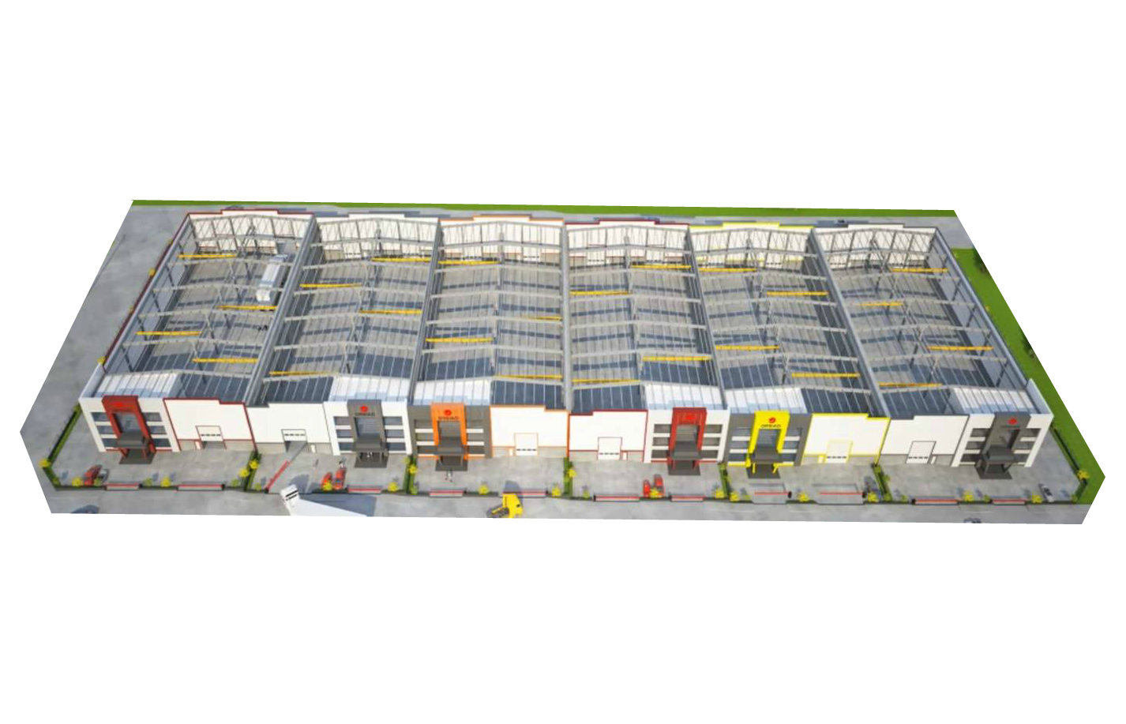
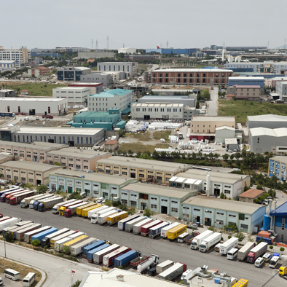
Brownfield
2000-5000 м²
1 м² için
130.000-150.000 ₸( 338-390 usd)
Purchase price
Installment condition (for 5 years 7% )
250 - 1000 ₸ (0.65-2.60 usd)
Monthly rent

Slide 4
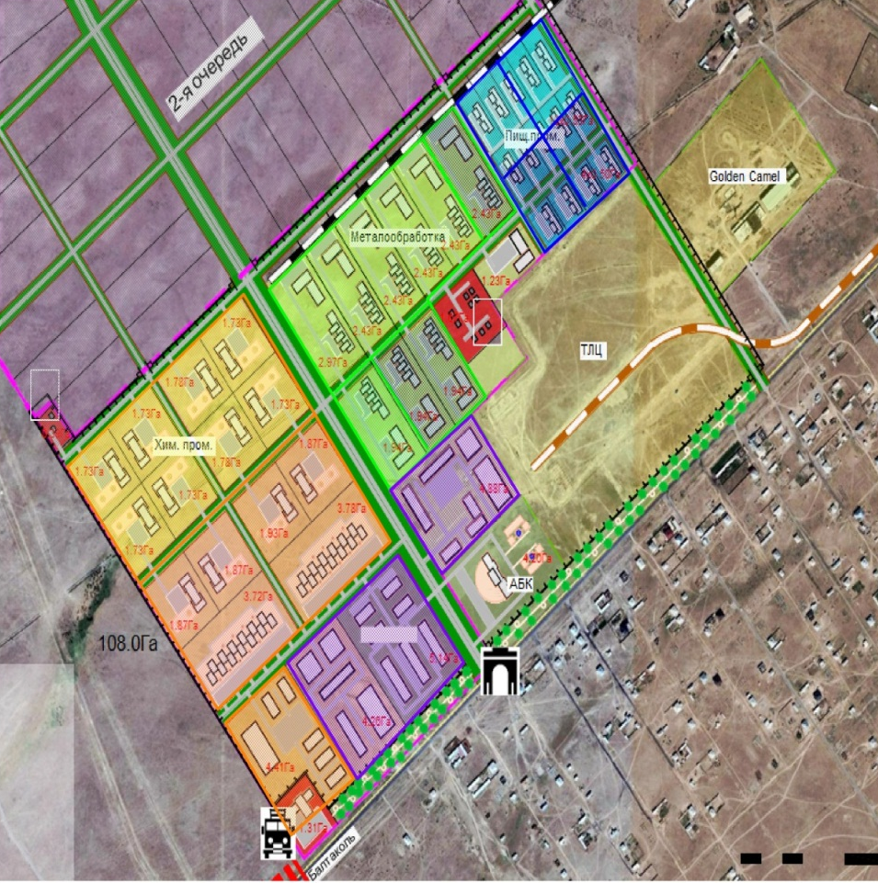
Greenfield
Projects placement 1st stage
for 1 м² - 14 ₸ / year(0.03 usd)
Light industry
Chemical Industry
IV,V level
І,ІІ,ІІІ level
Metallurgy
ІІІ,IV,V level
І,ІІ level
Construction Industry
ІІІ,IV level
І,ІІ level
* Also in other sectors(in 2. ve 3. levels)

